Slide 1


House Price Prediction
Predict the sales price for each house.
Students: Oriola Arifi, Viona Paqarizi, Armend Shala, Brahim Mustafa, Eos Musliu
Professor: Gëzim Sejdiu
www.universum-ks.org
DATE: 08.01.2026

Slide 2

Agenda
Introduction & Problem Statement
Dataset Overview & EDA
Data Preprocessing
Feature Engineering
Model Selection
Model Evaluation
Results
Demo
Conclusions, Future Work & Lessons Learned

Slide 3

Introduction & Problem Statement
House price prediction is a classic regression problem in Data Science and a key task in the real estate domain.
Residential property prices are influenced by multiple factors, including size, quality, location, construction year, and sale conditions.
In this project, we aim to learn a predictive model that maps property characteristics to the final sale price using the Ames Housing dataset from Kaggle.
The main challenge lies in handling missing values, a large number of categorical features, and a highly right-skewed target variable (SalePrice).

Slide 4
Dataset Overview
Target: SalePrice
Dataset: Ames Housing (Kaggle)
Training set: 1,460 observations (81 columns including SalePrice)
Test: 1,459 observations (80 columns)
Mixed feature types: numerical (area, year, rooms) and categorical (neighborhood, quality ratings)
Exploratory Data Analysis (EDA) was primarily conducted on the training dataset to examine feature distributions, missing values, and relationships with the target variable (SalePrice).
The test dataset was used only to verify dataset structure, feature consistency, and missing-value patterns, ensuring compatibility with the trained model and avoiding data leakage.

Slide 5
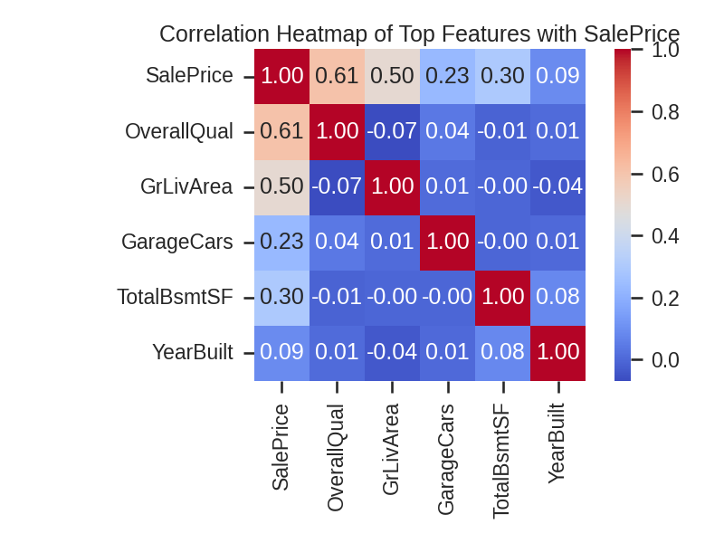
EDA – Target Variable & Missing Values
• Target variable: SalePrice is right-skewed; therefore, a log1p transformation is applied before modeling.
• Most properties are concentrated in the mid-price range, with a limited number of high-value outliers.
• Missing values often represent the absence of property features (e.g., basement, garage, pool) rather than unknown data.
• For categorical features, valid categories such as "None" are used to indicate absence, while numeric quantities for absent features are set to zero.

Slide 6
EDA – Feature Relationships & Outliers
• Strong positive relationships were observed between SalePrice and key features such as GrLivArea and OverallQual.
• Other variables, including GarageCars and TotalBsmtSF, also show moderate positive correlation with house prices.
• Visual inspection using scatter plots revealed the presence of outliers, particularly for large living areas (e.g., GrLivArea > 4000 sqft).
• No data points were removed during EDA; potential outliers were handled carefully during the modeling stage to preserve information.

Slide 7
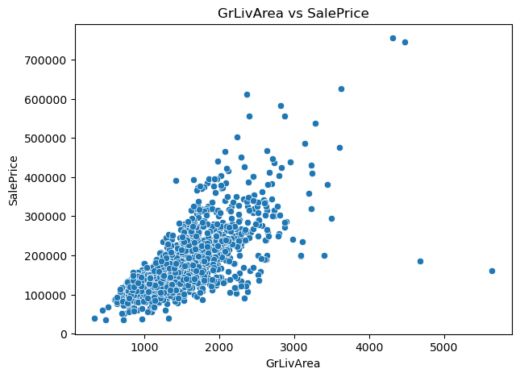
EDA – Feature Relationships & Outliers

Slide 8

Data Preprocessing
Removed non-informative identifiers (e.g., Id) and inspected very sparse columns.
Missing values were handled using domain knowledge:
“Missing = feature not present” → categorical amenities filled with "None"
Absent numeric quantities (e.g., basement-related areas) filled with 0
Remaining numeric features were imputed using median values where appropriate.
Categorical variables were encoded using one-hot encoding
Data was split into training and validation sets, ensuring consistent preprocessing for the test data

Slide 9
Feature Engineering
Implementation Details:
Domain knowledge was applied to correctly interpret missing values versus true feature absence.
Categorical attributes related to optional amenities (garage, basement, fireplace) were filled with "None" when not present.
Numeric features corresponding to absent structures (e.g., basement area, garage area) were filled with 0 to preserve semantic meaning.
This approach implicitly captures the presence or absence of key amenities without introducing additional indicator variables.
Feature transformations were applied consistently to both training and test datasets to avoid data leakage.
Grouped variables into numeric (areas, counts, years) and categorical (neighborhood, style, zoning, quality).
Strong predictive features identified through EDA and correlation analysis:
OverallQual
GrLivArea
TotalBsmtSF
GarageCars / GarageArea
YearBuilt

Slide 10
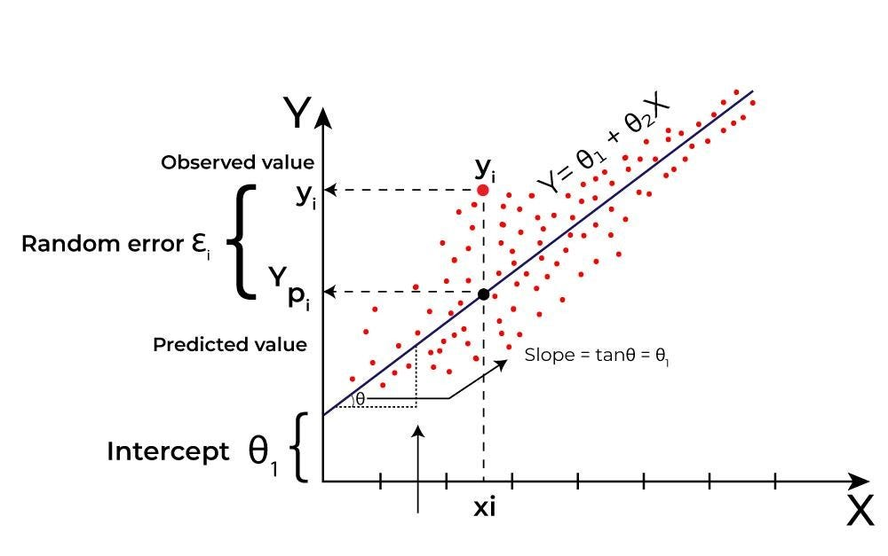
Model Selection
We began with a baseline regression model (linear/regularized regression)
as a reference point.
Tree-based ensemble models were then evaluated to capture non-linear
relationships and feature interactions.
Gradient Boosting Regressor was selected due to its strong performance,
robustness to outliers, and ability to model complex patterns in the data.
Model comparison and selection were performed using 5-fold cross-validation.
Hyperparameters were tuned using GridSearchCV, including:
n_estimators, learning_rate, max_depth, and min_samples_leaf.

Slide 11
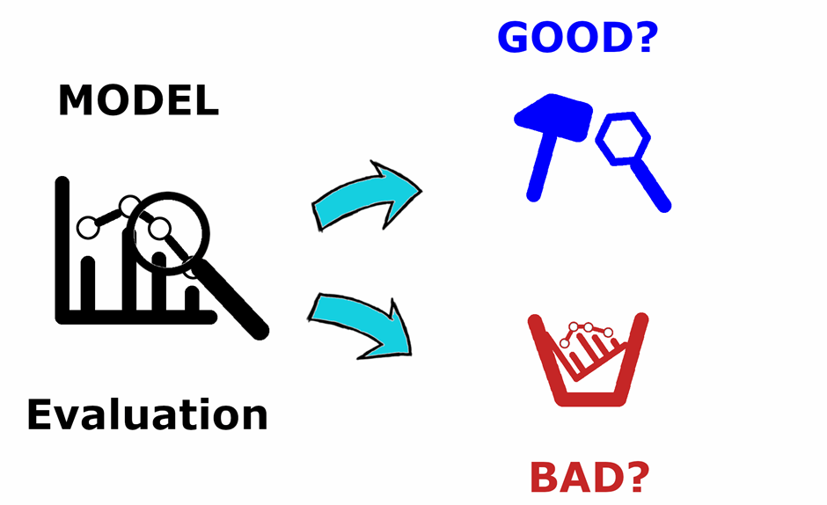
Model Evaluation
Train/validation split + 5-fold cross-validation
to estimate generalization.
Primary metric: RMSE on log(SalePrice) to
reduce skew and penalize large errors.
Diagnostics included:
• Predicted vs Actual (closely to aligned with the diagonal)
• Residual distribution (centered around 0)
Verified pipeline runs consistently and generated submission-ready predictions.

Slide 12
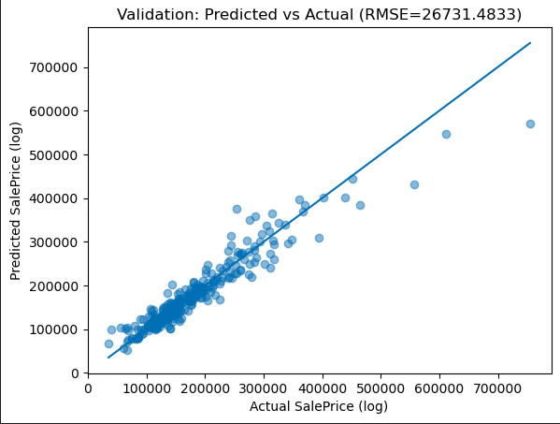
Results
• Gradient Boosting Regressor (final model)
Best 5-fold Cross-Validation RMSE (log scale): 0.1348
Optimal hyperparameters:
- learning_rate = 0.05
- max_depth = 3
- min_samples_leaf = 5
- n_estimators = 800
Hold-out validation (80/20 split):
- Validation RMSE (original scale): ≈ 26,700
- Validation R²: ≈ 0.91
• Submission file generated for 1,459 test houses

Slide 13
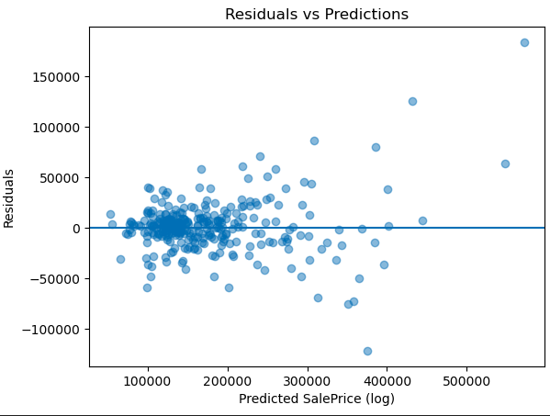
Residual Analysis
• Residuals are generally centered around zero, indicating no strong systematic bias.
• The spread of residuals increases slightly for higher predicted prices, which is expected
due to higher variability in expensive properties.
• No clear patterns are observed, suggesting that the model captures the main structure
of the data reasonably well.

Slide 14
Demo
Live demonstration of the model implementation and prediction workflow.

Slide 15
Proper preprocessing and feature engineering were crucial for model performance, with tree-based models performing best. Future work includes experimenting with LightGBM and CatBoost, incorporating external data sources (e.g., schools, crime rates), and applying more robust outlier detection techniques. Key lessons learned: • Exploratory Data Analysis (EDA) helps identify data issues early. • Correct handling of missing values significantly improves model performance. • Cross-validation is essential for reliable evaluation and reducing overfitting.
Conclusions,
Future Work & Lessons Learned

Slide 16




THANK YOU
Kolegji Universum
universumcollege
universuminternationalcollege
info@universum-ks.org
www.universum-ks.org
DATE: 08.01.2026

